Slide 1
Docker
Presented by: Aarti Bhosale

Slide 2
Agenda
Docker Overview
What & why Docker
Docker container Vs VM
Container
Docker architecture
Docker workflow
Docker commands
Use cases of Docker
Dockerfile
Demo

Slide 3
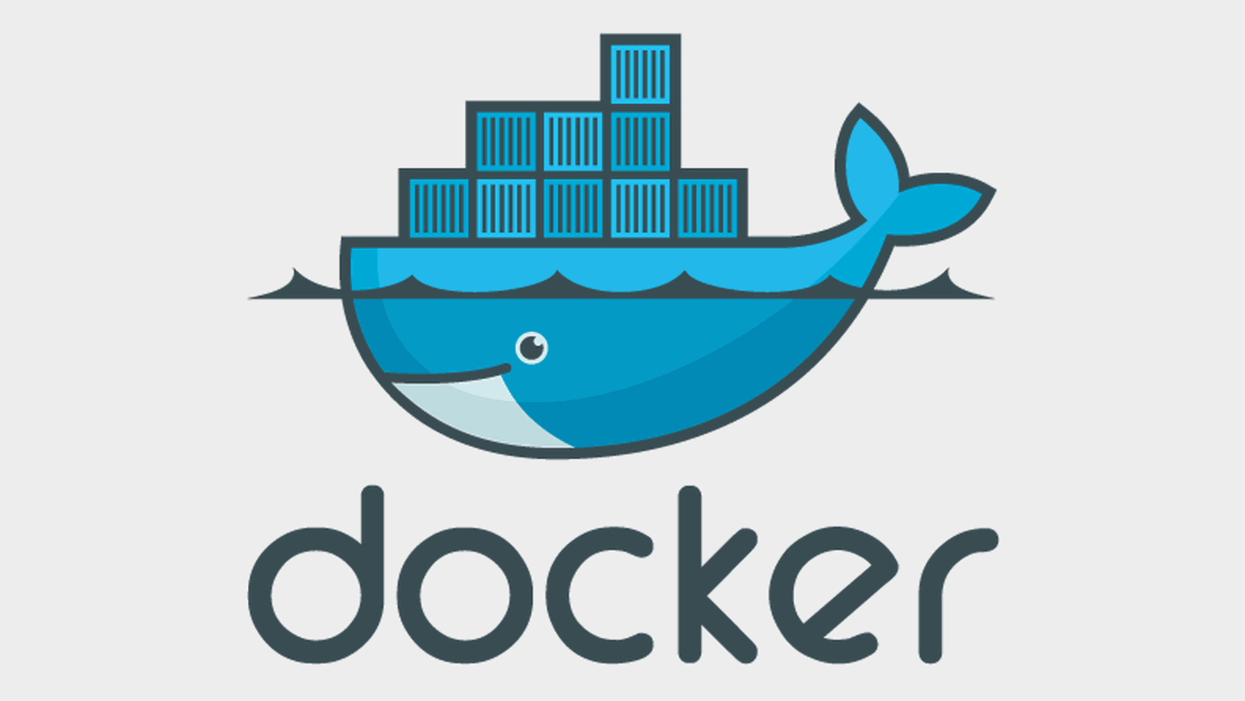
Docker Introduction
Started in France by Hykes within dotCloud
Released as open source in March 2013
Developed in Go programming language
OS-Level virtualization
Used by Millions of user

Slide 4
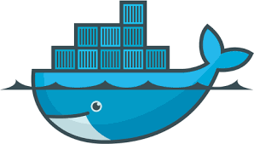
Docker Community
3330+ contributors
242+ billion docker pull
3.1K GitHub stars
7M hub users
2.9M desktop installation
20-30% of companies adopted docker
70-75% deployment
Reference: https://github.com/docker/docker.github.io

Slide 5
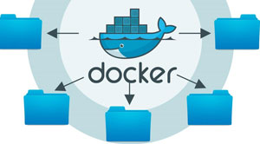
What is Docker?
It is tool used to automate deployment of application in the form of lightweight container so application can work efficiently on different platform.
It is open source tool
Easy to create, deploy & run application using container
Package your application along with all its dependencies together in form of container
Able to manage infrastructure just like application
Boost application performance and reduce size of application

Slide 6

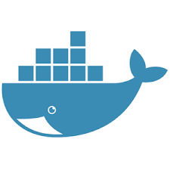
Why Docker?
Couple of reasons to use docker -
Faster delivery
Light weight
Efficient use of system resources
Portability
Sharability
Supported by all cloud platform
Why Develop with Docker?

Slide 7
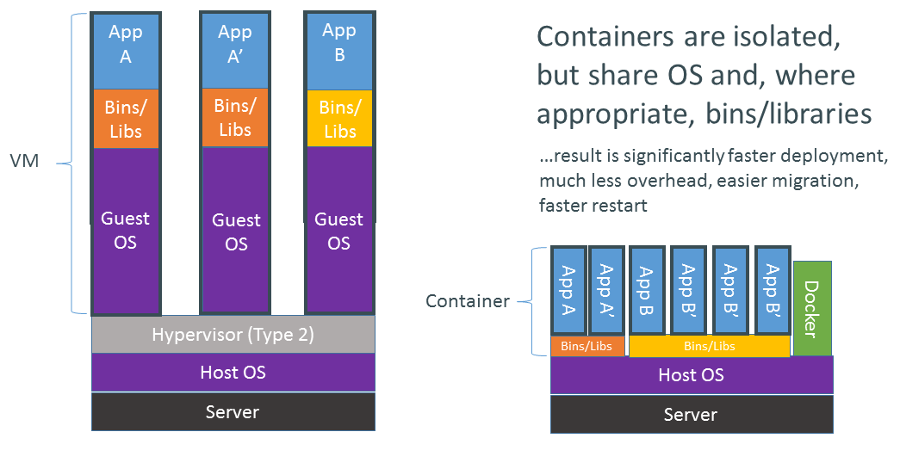
Container vs VM

Slide 8
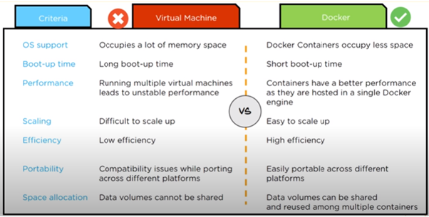
Docker container vs VM

Slide 9
Why should we care for Docker
For Developers
For DevOps
Portable App containers
Build, test & package on production like environment
Increase the quality of code produced by Developers
Fast and simple
16,000+ apps available on Docker Hub
Reducing “works on my machine” finger-pointing
Helps Infra teams to deploy & run any App on any infrastructure
Entire lifecycle more efficient and repeatable
Compared to VM's, reduces costs & improves speed
Deployment & Release Automation
Perfect for DevOps – CI, CD, Release, Scaling, Clouds, etc
Simple creation of Environments
Provide standard Environments for Dev, Test & Production

Slide 10
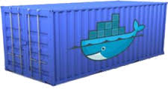
What is containers?
Standardized unit of software
Portable packaging for application
Run everywhere
Small, lightweight & fast

Slide 11
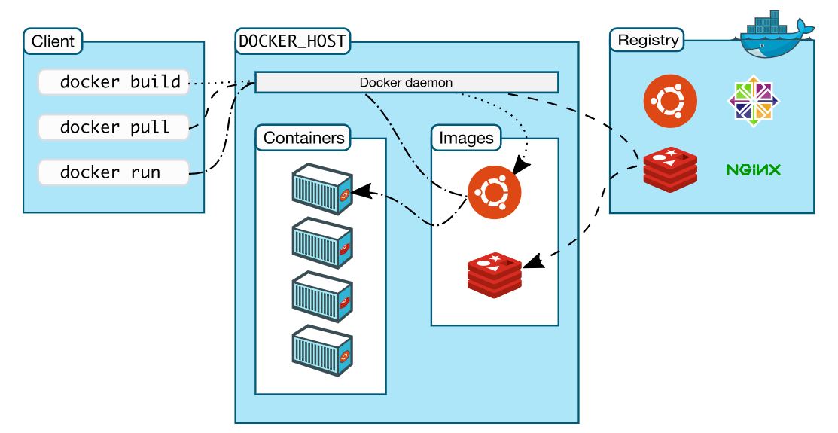
Docker Architecture

Slide 12
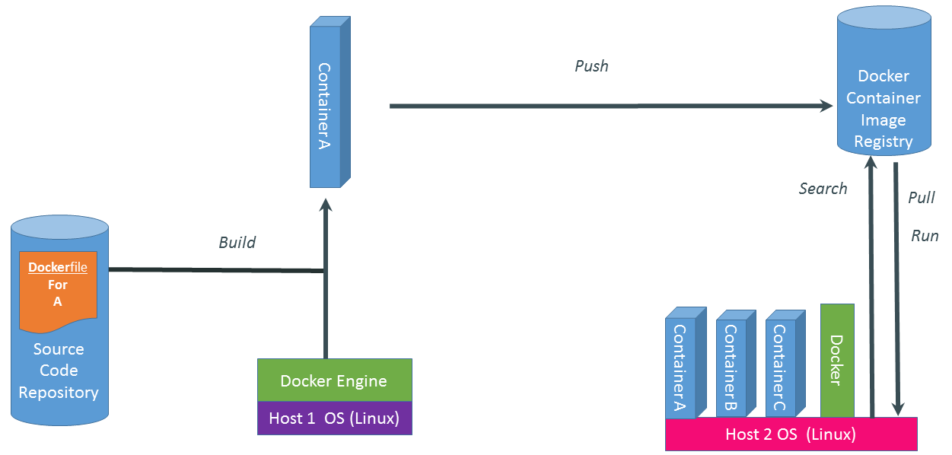
Docker Workflow

Slide 13
Docker Commands
Few basic docker commands
Command | Description
version | Get the currently installed docker version
pull | Pull the images from docker repository
run | Create container from an image
ps | List the running container
ps -a | Show all the running and exited container
exec | Access the running container
stop | Stops a running container
kill | Kills the container by stopping its execution immediately
save | Save an image to a tar archive

Slide 14
Docker Commands
Command | Description
commit | Creates a new image of an edited container on the local system
login | Login to the docker registry server
push | Push an image to the docker registry
images | Lists all the locally stored docker images
rm | Delete a stopped container
rmi | Delete an image
build | Build an image from specified dockerfile
logs | Fetch the logs of a container
start | Start a stop container
restart | Restart a running container

Slide 15
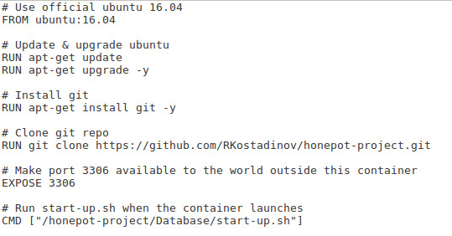
What is Dockerfile?
Dockerfile is plain text file which contains all commands/instruction in order to, needed to build a given image.
Example:

Slide 16
Dockerfile Instruction
Basic instruction used in Dockerfile
Instruction | Description
FROM | Specify base image
WORKDIR | Set working directory
ADD | Copy files, directories or remote url files to container image
COPY | Copy files, directories to container image
RUN | Execute specific command
CMD | Specify command at the time of container execution
ENTRYPOINT | Configure and run container as an executable
ARG | Defines variable that user can pass at a build time
LABEL | Specify metadata information in key-value pair

Slide 17
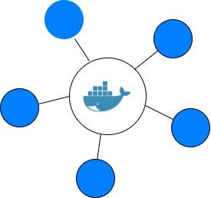
Use Cases for Docker
Automate packaging & deployment of Applications
Isolation
Simplifying configuration
Developer Productivity
Rapid Deployment
Continuous integration/deployment
Better disaster recovery
Scaling Web apps, databases and backend services
Micro-services architecture / Service orchestration & discovery

Slide 18


Copyright © 2021 Cybage Software Pvt. Ltd. All Rights Reserved. Cybage Confidential.
www.cybage.com

Slide 19


Thank You!
2/10/2021
www.cybage.com
Copyright © 2021 Cybage Software Pvt. Ltd. All Rights Reserved. Cybage Confidential.

